Slide 1
MyPHR
Intelligent UI Implementation

Slide 2
Overview
Intelligence Implementation
Devices and Tools
Algorithms
Vital Signs
Reminders
Tests Results
Demo
Challenges

Slide 3
Intelligence Implementation
Lack of feedback to the user
No validation of entries
Reminders
Hidden in the menu
Only the advanced user will set it up

Slide 4
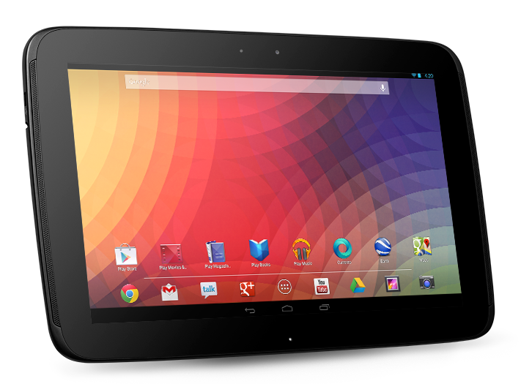
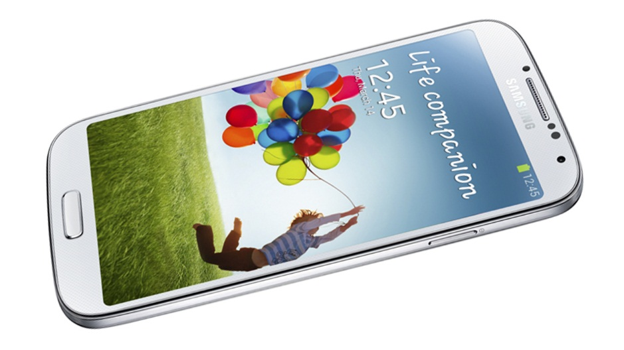

Devices and Tools
Nexus 10
Android 4.4
10.1 inches display
Samsung Galaxy S4
Android 4.3.1
5 inches display
Eclipse IDE (ADT Bundle)

Slide 5
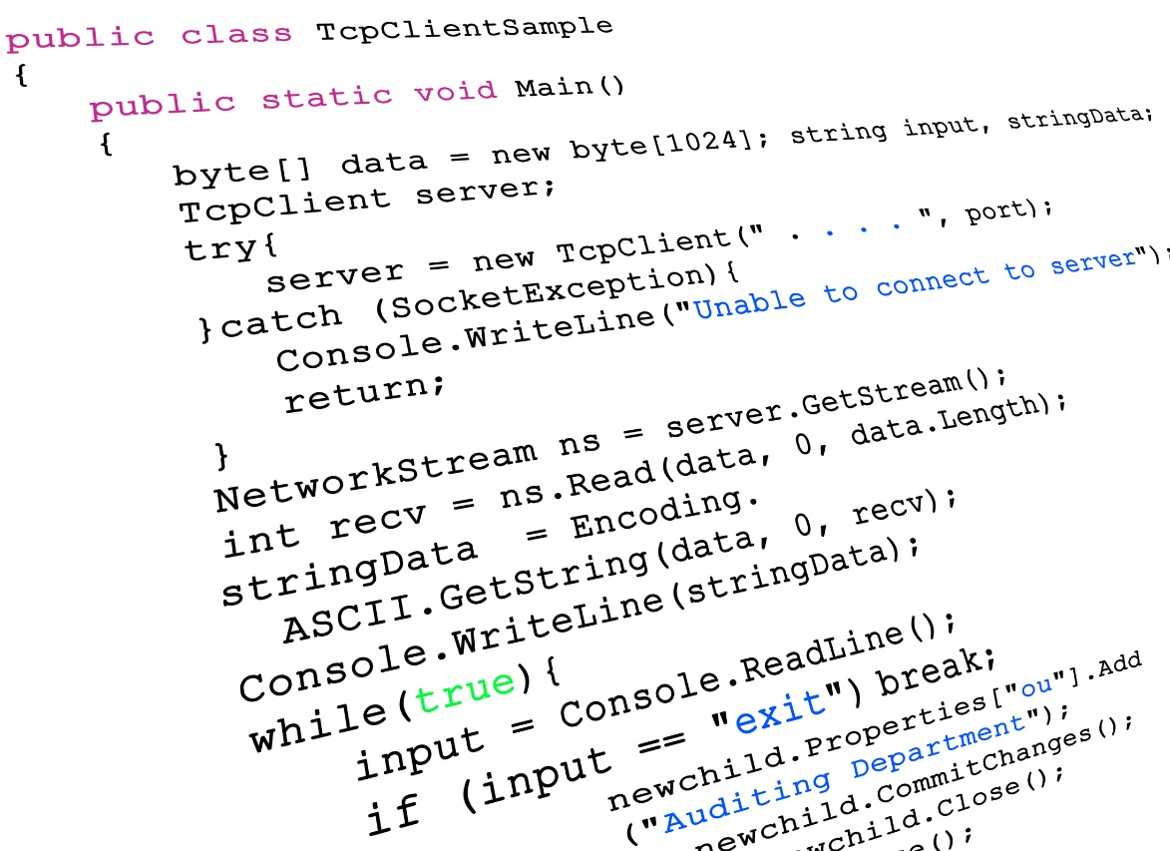
Code
Classes
VitalSignActivity
BloodPressureActivity
BloodSugarActivity
O2Activity
TemperatureActivity
WeightActivity
Their Data Mappers and TDGs

Slide 6
Intelligence Implementation - continued
Dynamic Reminders
Based on a week of previous time entries
Uses implemented reminder functionality to create reminders for users
Smart Alerts
Based on a week of previous Vital Sign entries
Notifies user if data seems incorrect

Slide 7
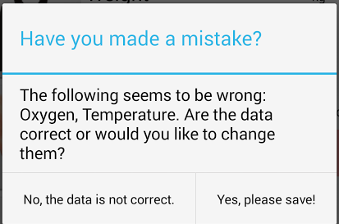
Algorithms: Vital Signs
Vital Signs are gathered for a week
Verification starts after a week
Based on normal measurements and normal changes
User prompted to correct data to accept entry on invalid entries

Slide 8
Algorithms: Vital Signs – Blood Sugar
Blood Sugar varies depending on time and how much you ate
Abnormal Readings
Blood Sugar < 80 mg/dL or Blood Sugar > 160 mg/dL
Blood Sugar fluctuations > 40 mg/dL
Time of day | Low level (mg/dL) | High Level (mg/dL)
Before meal/Morning | 80 | 120
Two hours after eating | - | >140 (age<51); >160 (age>59)
Bedtime | 100 | 140

Slide 9
Algorithms: Vital Signs – Temperature
Human Body Temperature: 37°C
Fluctuates about 0.5°C throughout the day
Abnormal Readings
Fluctuation greater than 0.5°C
36.5°C > Temperature or 37.5°C < Temperature

Slide 10
Algorithms: Vital Signs – Weight
Healthy weight gain/loss ≈1.5 lb. per week (0.68 kg per week)
Abnormal Readings
Weekly Weight Changes > 1.5 lb.

Slide 11
Algorithms: Vital Signs – Blood Pressure
Measured when HR is at rest
Abnormal Readings
Systolic < 90 or Diastolic < 60
Systolic > 120 or Diastolic > 80
Category | Systolic (mmHG) |  | Diastolic (mmHG)
Low Blood Pressure | < 90 | Or | <60
Normal | < 120 | And | < 80
Prehypertension | 120 – 139 | Or | 80 – 89
High Blood Pressure (stage 1) | 140 – 159 | Or | 90 – 99
High Blood Pressure (stage 2) | > 160 | Or | > 100

Slide 12
Algorithms: Vital Signs – O² Saturation
Normal range for Oxygen Saturation is 95% to 100%
Abnormal Readings
O² Saturation > 95% or O² Saturation < 100%

Slide 13
Algorithms: Reminders
Like Vital Signs – Data Gathered for a week
Method
Get # of different days entered (e.g. Mon, Wed, Fri → 3)
Number of Reminders = # of Time Entries / Different Days
Number of Time Blocks = 24 / # of Reminders (e.g. 3 reminders → 8 Hr Timeblocks)
Time entries are put into the time blocks and the average of each time is calculated
Then based on the average time for each time block, reminders are created
Reminders are created for future dates upon app launch.

Slide 14
Evaluation
Two participants
Demoed basic usage of the application
Showed our implementation
Provided 1 week’s worth of data for them to enter
Think out load
Reminders were not test

Slide 15
Evaluation - Participants
PARTICIPANT 1
Participant 2
Woman in her late 60s
Uses a computer and tablet
Facebook, Youtube, Skype, Games, News
Was taught previously how to use devices
Doesn’t speak English
Woman in her late 80s
Never used a tablet or computer
Uses TV and CD Player
Doesn’t speak English

Slide 16
Evaluation - Results
Participant 1
Participant 2
Fast Learner
Test 1: 75s; Test 2: 45s
Positive Feedback from tests
Not interested, no patience and no "self-confidence“
Had trouble due to eye problems
Test 1: 5 minutes

Slide 17
Demo

Slide 18
Challenges
New to mobile development
Was not familiar with Android development
Short time frame to learn (work)
Testing
Short time frame to test
Not enough users to test our IUI

Slide 19
References

